Slide 1
Topic Modeling
Peitian Zhang
Renmin University of China
Currently @ MSRA Social Computing

Slide 2
Outline
Overview
Traditional Methods

Slide 3
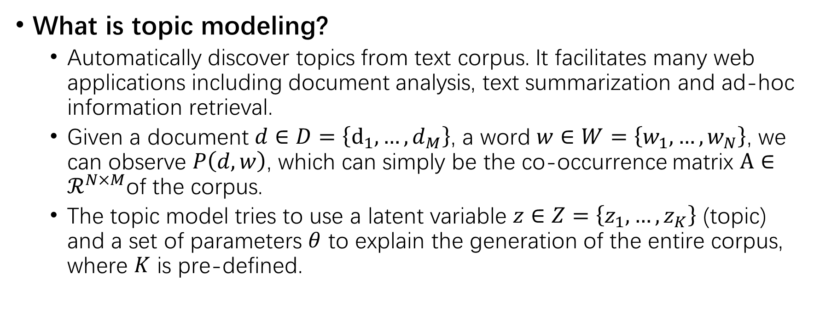
Overview
What is topic modeling?
Automatically discover topics from text corpus. It facilitates many web applications including document analysis, text summarization and ad-hoc information retrieval.
Given a document $d∈D=\left\{d_{1},…, d_{M}\right\}$, a word $w∈W=\left\{w_{1},…,w_{N}\right\}$, we can observe $P\left(d,w\right)$, which can simply be the co-occurrence matrix $A∈ℛ^{N×M}$of the corpus.
The topic model tries to use a latent variable $z∈Z=\left\{z_{1},…,z_{K}\right\}$ (topic) and a set of parameters $θ$ to explain the generation of the entire corpus, where $K$ is pre-defined.

Slide 4
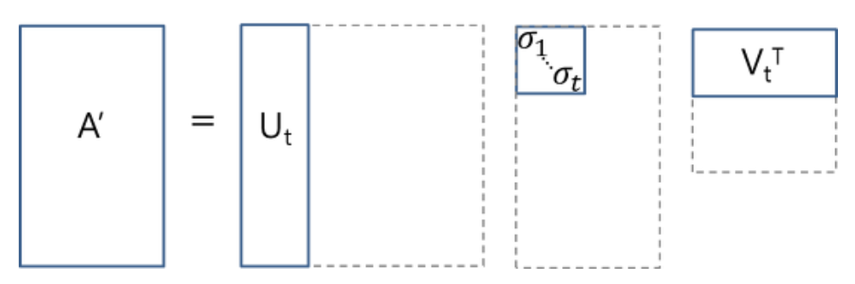
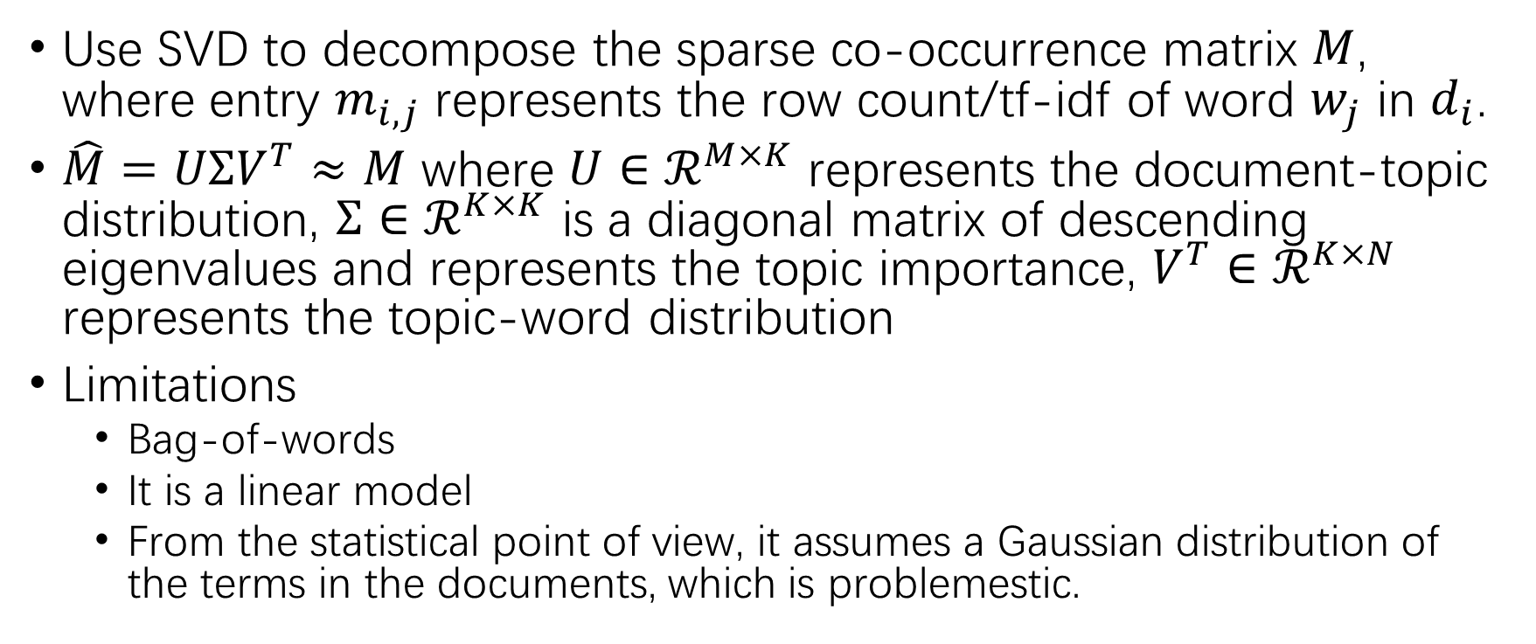
LSA
Use SVD to decompose the sparse co-occurrence matrix $M$, where entry $m_{i,j}$ represents the row count/tf-idf of word $w_{j}$ in $d_{i}$.
$\hat{M}=UΣV^{T}≈M$ where $U∈ℛ^{M×K}$ represents the document-topic distribution, $Σ∈ℛ^{K×K}$ is a diagonal matrix of descending eigenvalues and represents the topic importance, $V^{T}∈ℛ^{K×N}$ represents the topic-word distribution
Limitations
Bag-of-words
It is a linear model
From the statistical point of view, it assumes a Gaussian distribution of the terms in the documents, which is problemestic.

Slide 5
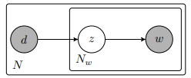
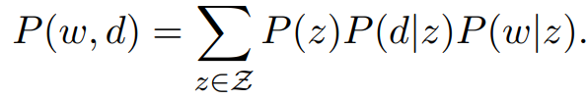
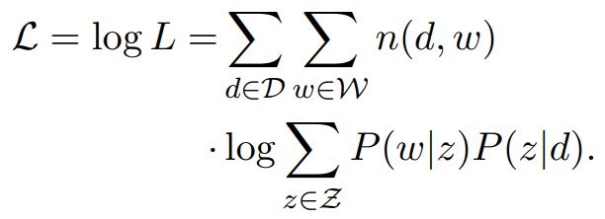
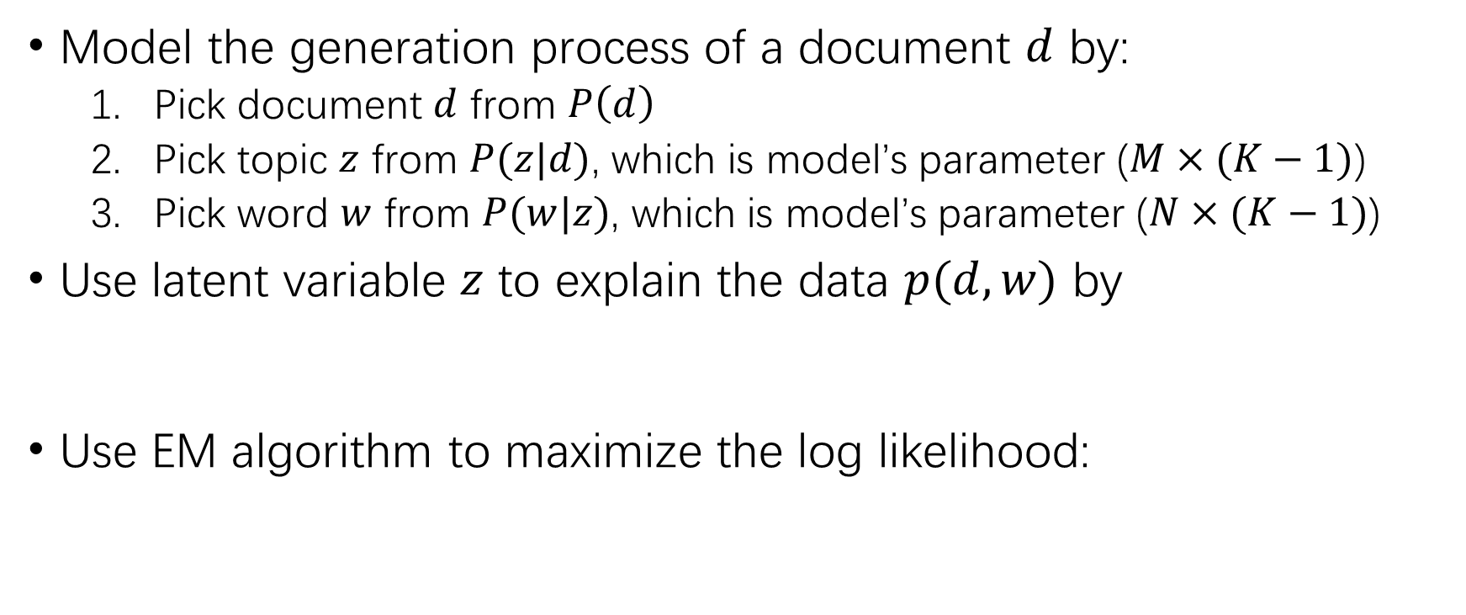
PLSA
Model the generation process of a document $d$ by:
Pick document $d$ from $P\left(d\right)$
Pick topic $z$ from $P(z|d)$, which is model’s parameter ($M×(K−1)$)
Pick word $w$ from $P(w|z)$, which is model’s parameter ($N×(K−1)$)
Use latent variable $z$ to explain the data $p(d,w)$ by
Use EM algorithm to maximize the log likelihood:

Slide 6
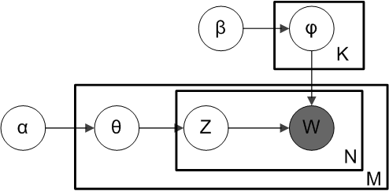
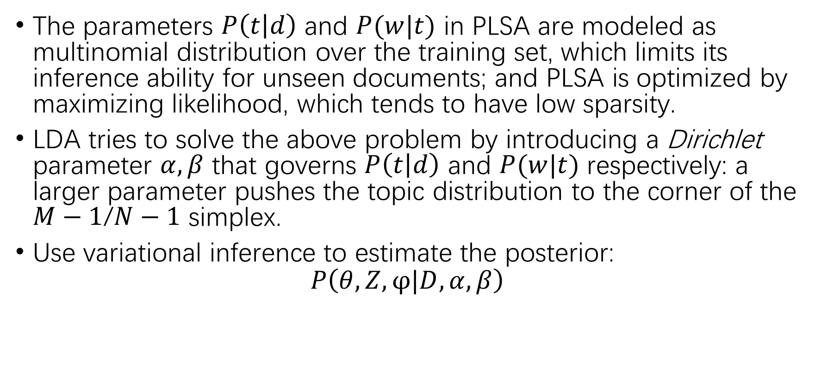
LDA
The parameters $P\left(t | d\right)$ and $P(w|t)$ in PLSA are modeled as multinomial distribution over the training set, which limits its inference ability for unseen documents; and PLSA is optimized by maximizing likelihood, which tends to have low sparsity.
LDA tries to solve the above problem by introducing a Dirichlet parameter $α,β$ that governs $P\left(t | d\right)$ and $P(w|t)$ respectively: a larger parameter pushes the topic distribution to the corner of the $M−1$/$N−1$ simplex.
Use variational inference to estimate the posterior:
$$P\left(θ,Z,φ|D,α,β\right)$$

Slide 7
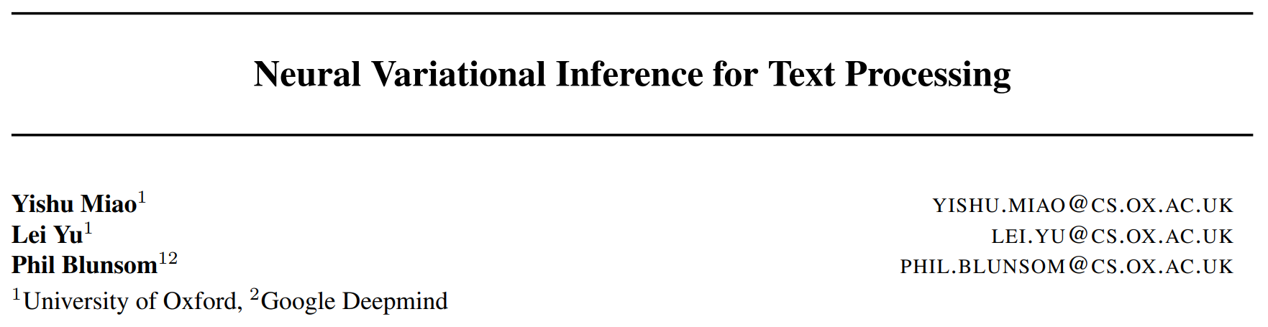
ICML 2016

Slide 8
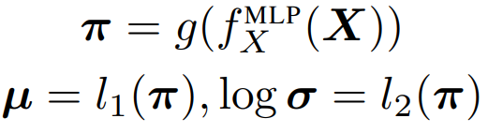
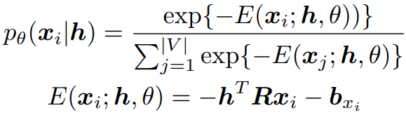
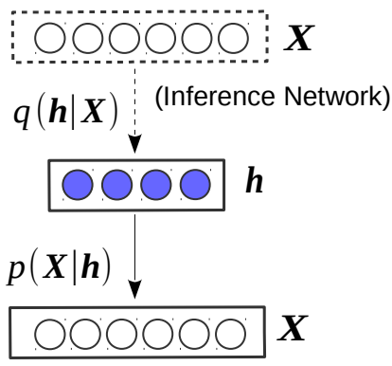
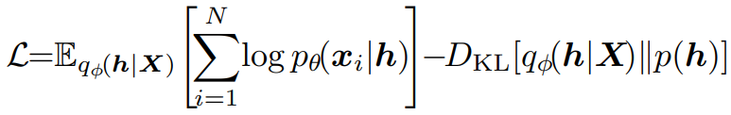
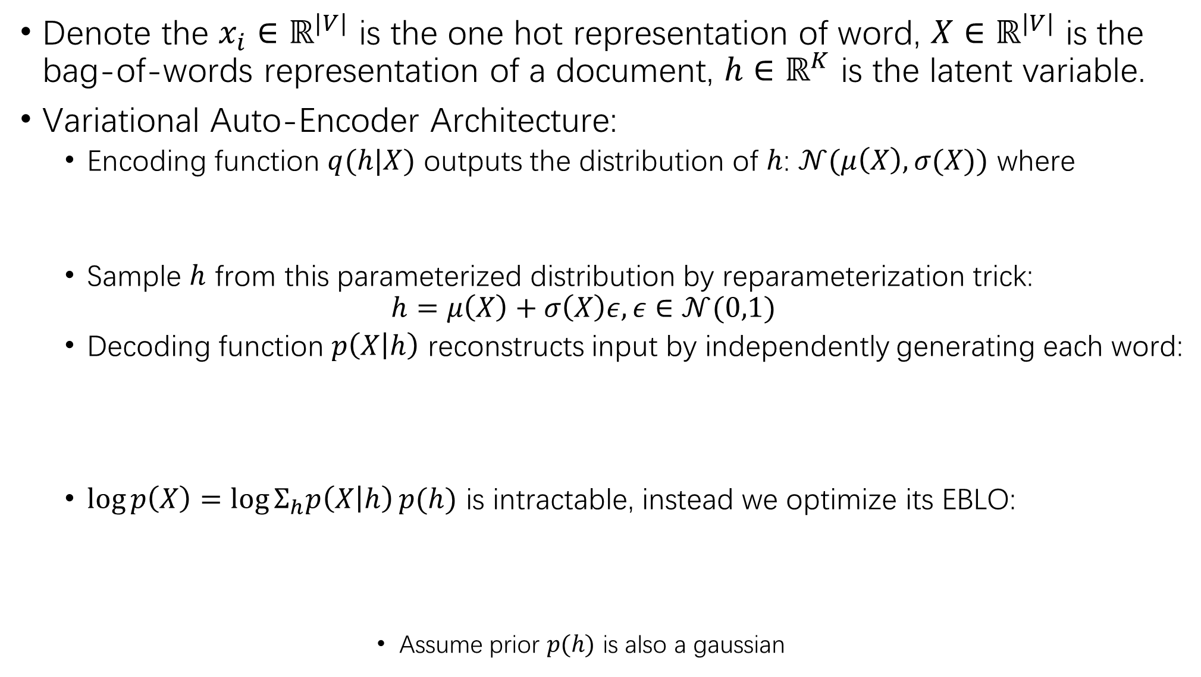
Denote the $x_{i}∈ℝ^{|V|}$ is the one hot representation of word, $X∈ℝ^{|V|}$ is the bag-of-words representation of a document, $h∈ℝ^{K}$ is the latent variable.
Variational Auto-Encoder Architecture:
Encoding function $q(h|X)$ outputs the distribution of $h$: $𝒩(μ\left(X\right),σ(X))$ where
Sample $h$ from this parameterized distribution by reparameterization trick:
$$h=μ\left(X\right)+σ\left(X\right)ε, ε∈𝒩(0,1)$$
Decoding function $p\left(X | h\right)$ reconstructs input by independently generating each word:
$\log{p\left(X\right)=\log{Σ_{h}p\left(X | h\right)}p(h)}$ is intractable, instead we optimize its EBLO:
Assume prior $p(h)$ is also a gaussian

Slide 9
